Slide 1
Medical Image Analysis with CNNs
Matthew Engelhard

Slide 2
Overview
What can CNNs do, and how is it relevant to clinical medicine?
How do CNNs work, in brief?
How do we (re)-train a model to classify medical images?
Notes on image data pre-processing (time permitting)

Slide 3
Overview
What can CNNs do, and how is it relevant to clinical medicine?
How do CNNs work, in brief?
How do we (re)-train a model to classify medical images?
Take an existing, trained classification model
Replace the final layer (i.e., prediction head)
Fine-tune model parameters
Notes on image data pre-processing (time permitting)

Slide 4
What can CNNs do?
Classification, Detection, Segmentation…

Slide 5
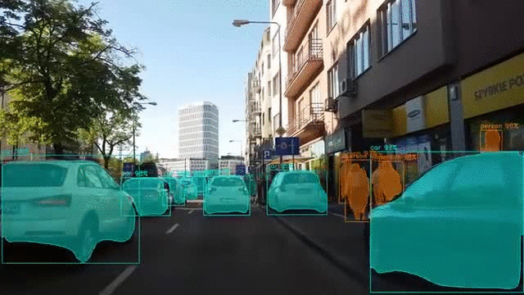
Computer Vision (with a CNN)
Notes:
Describe what’s happening here
Let’s break it down piece by piece…

Slide 6
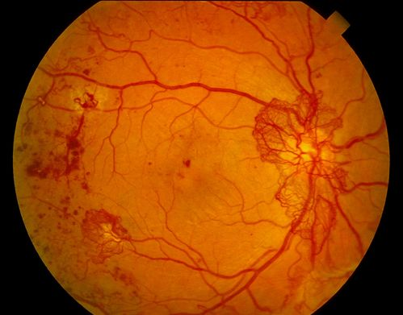
Binary Classification
Diabetic retinopathy? (Yes/No)
Gulshan et al. JAMA (2016)
Notes:
Ask for other examples

Slide 7

Multi-Class Classification
Image Label? (1000 classes)
Notes:
Contrast with binary case

Slide 8
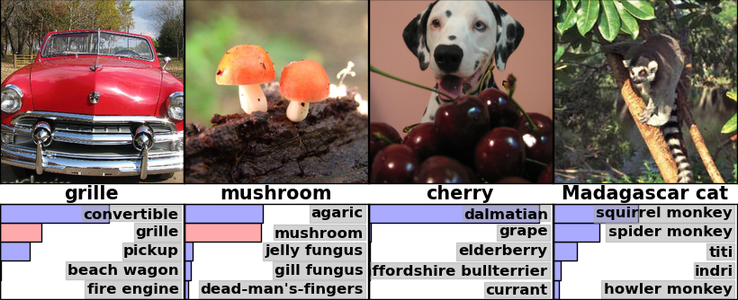
Multi-Class Classification
Notes:
Imagenet
Any problem with using classification for these examples?

Slide 9
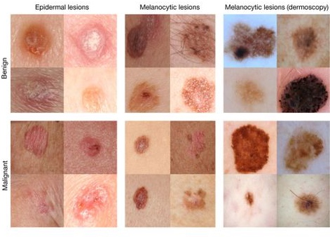
Multi-Class Classification
Dermatologist-level classification of skin cancer
Nature volume 542, pages 115–118 (02 February 2017)
Notes:
Could this be binary?
Could this be multi-class?
How many classes?

Slide 10
Object Detection
Notes:
Overcome limit of classification
Typically a limited number of classes
Describe output structure

Slide 11
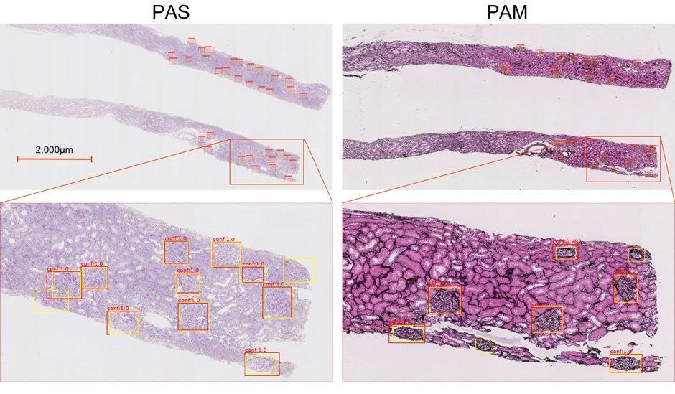
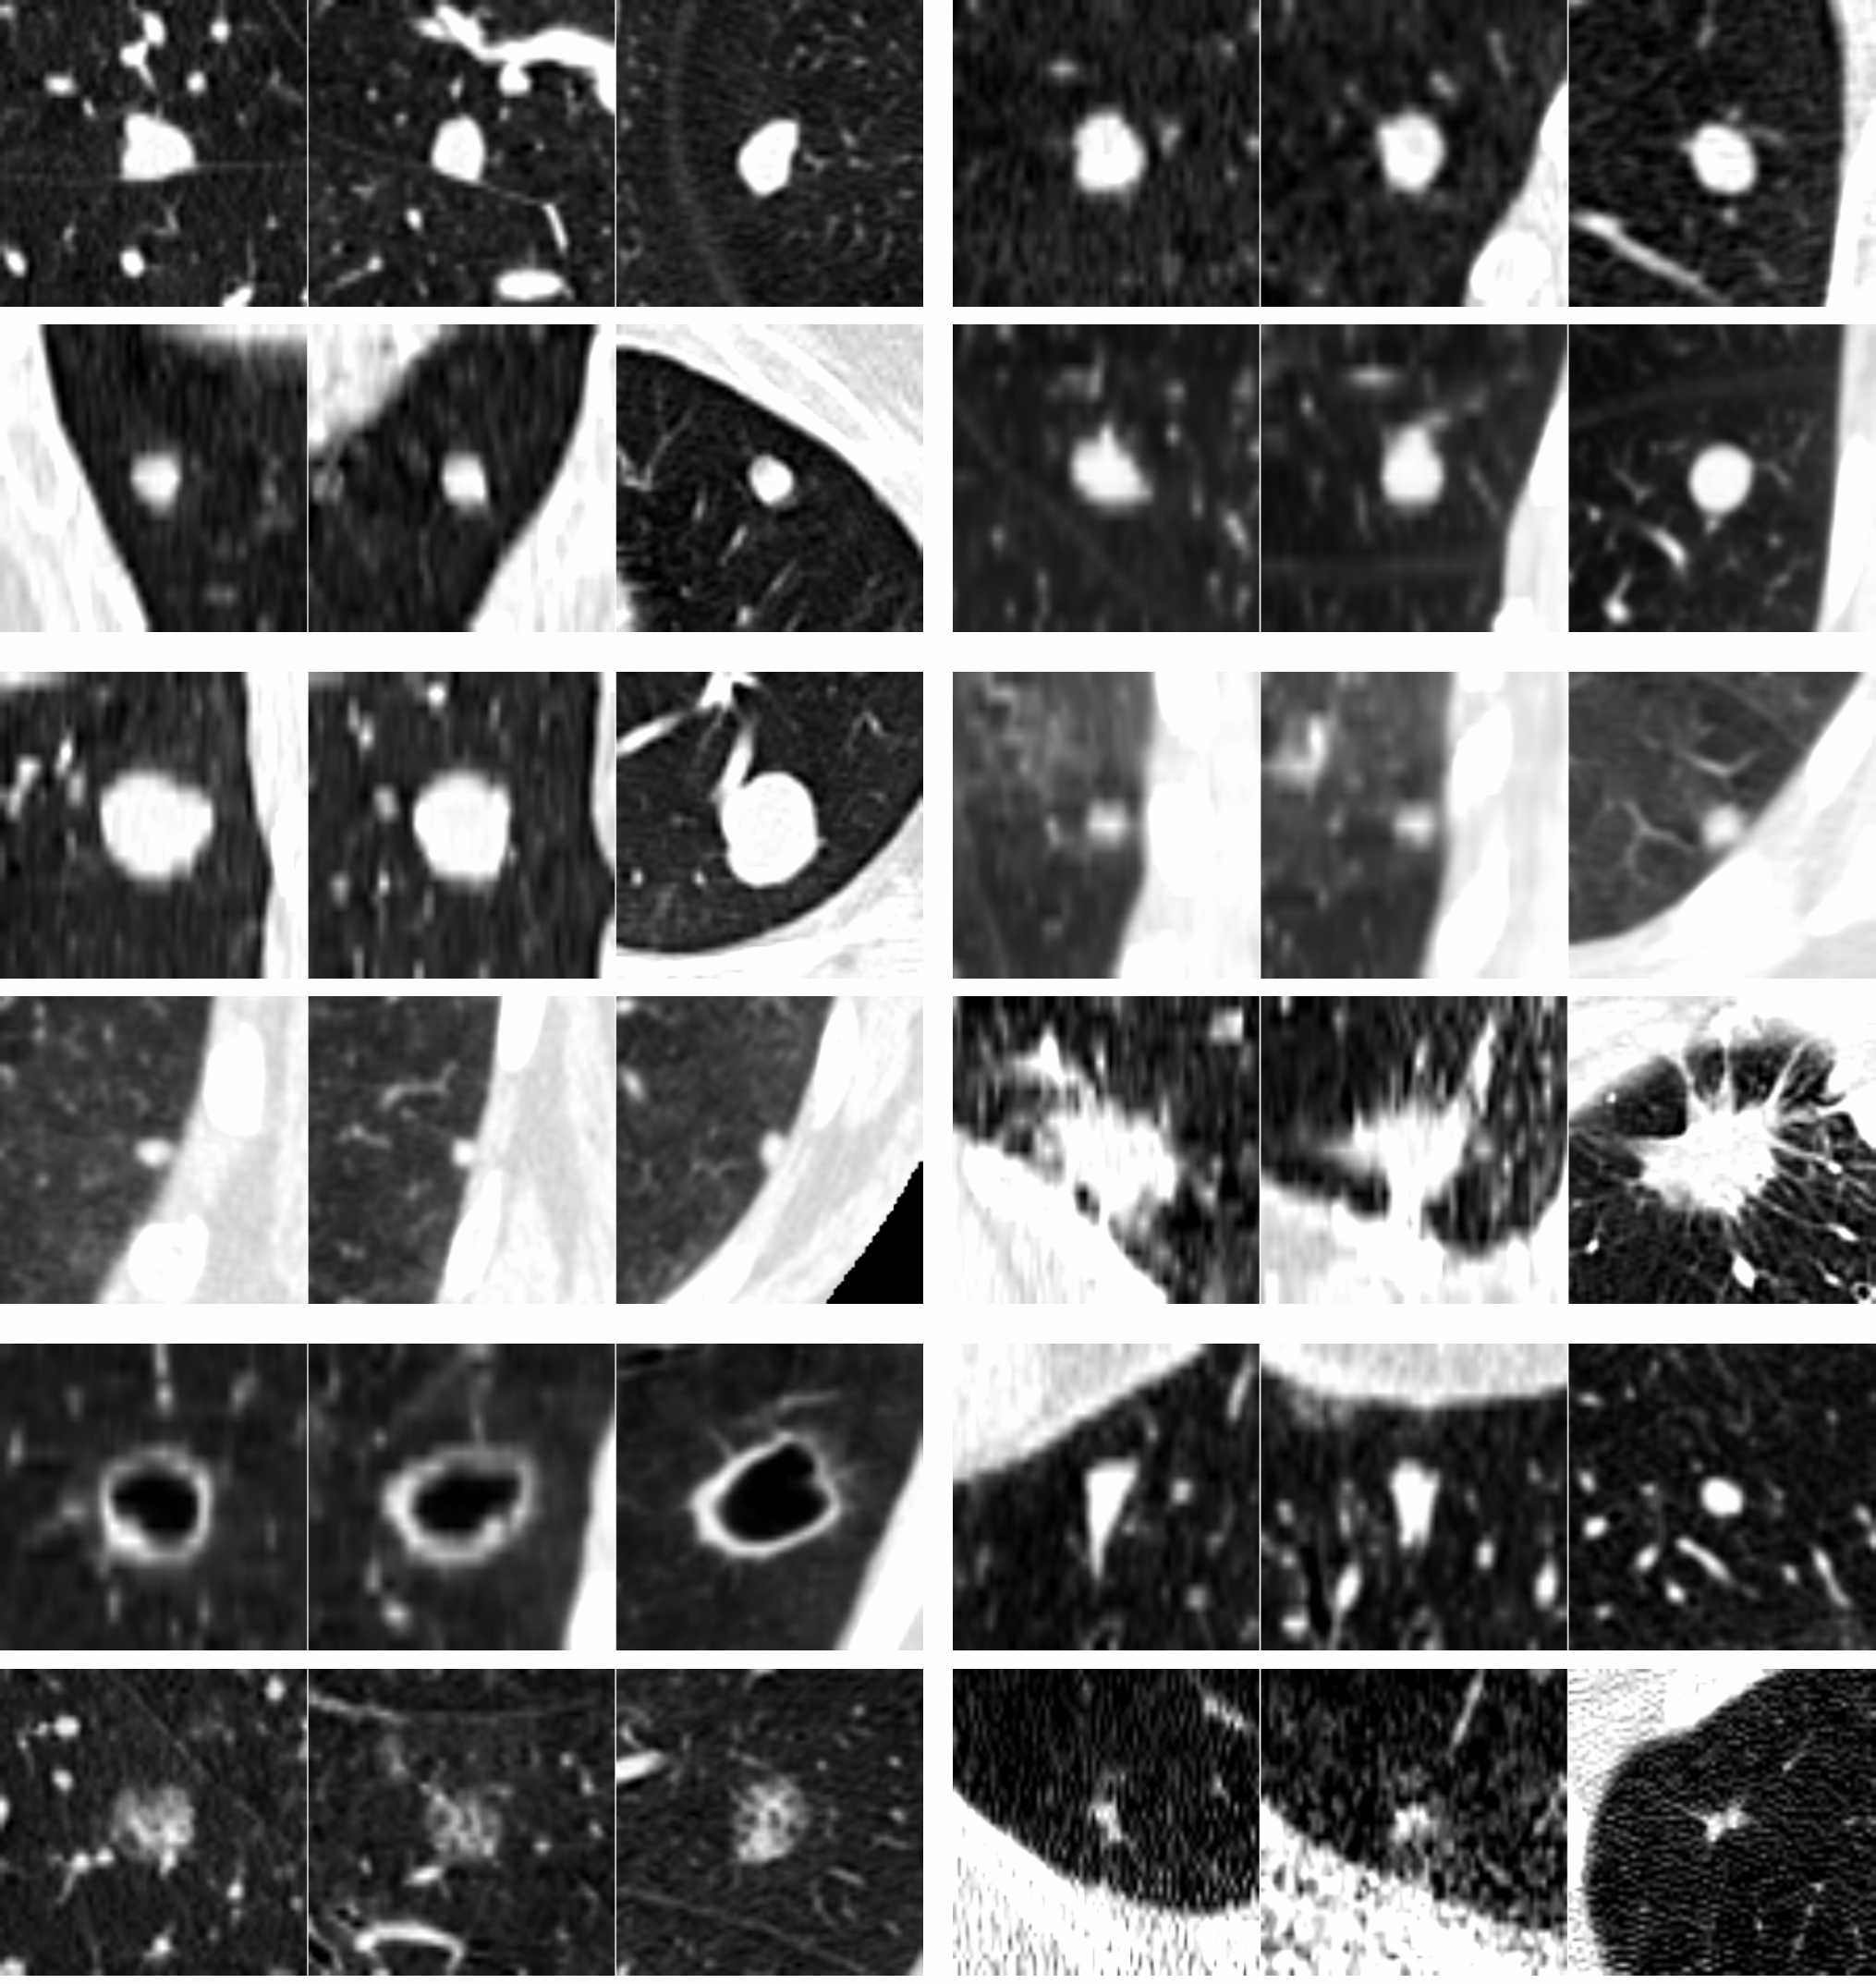
Object Detection in Medicine
Glomerular Detection with Faster-RCNN
Kawazoe et al., J. Imaging, 2018
Pulmonary Nodule detection in CT
van Ginneken et al., Biomedical Imaging, 2015
Notes:
Other examples in medicine?
High annotation cost

Slide 12
Semantic Segmentation
Notes:
Very high annotation cost
Does not distinguish between distinct objects

Slide 13
Segmentation of optic disc, fovea and retinal vasculature Journal of Computational Science, 20, 70-79 (2017).
Notes:
Identify boundaries of optic disc, fovea, blood vessels
“pixel-wise classification”
Similar to classification models

Slide 14
Detect objects, classify them, and define their boundaries (i.e. segment)
Notes:
Combines advantages of each

Slide 15
Why Segment? -> Precisely Identify Boundaries

Slide 16
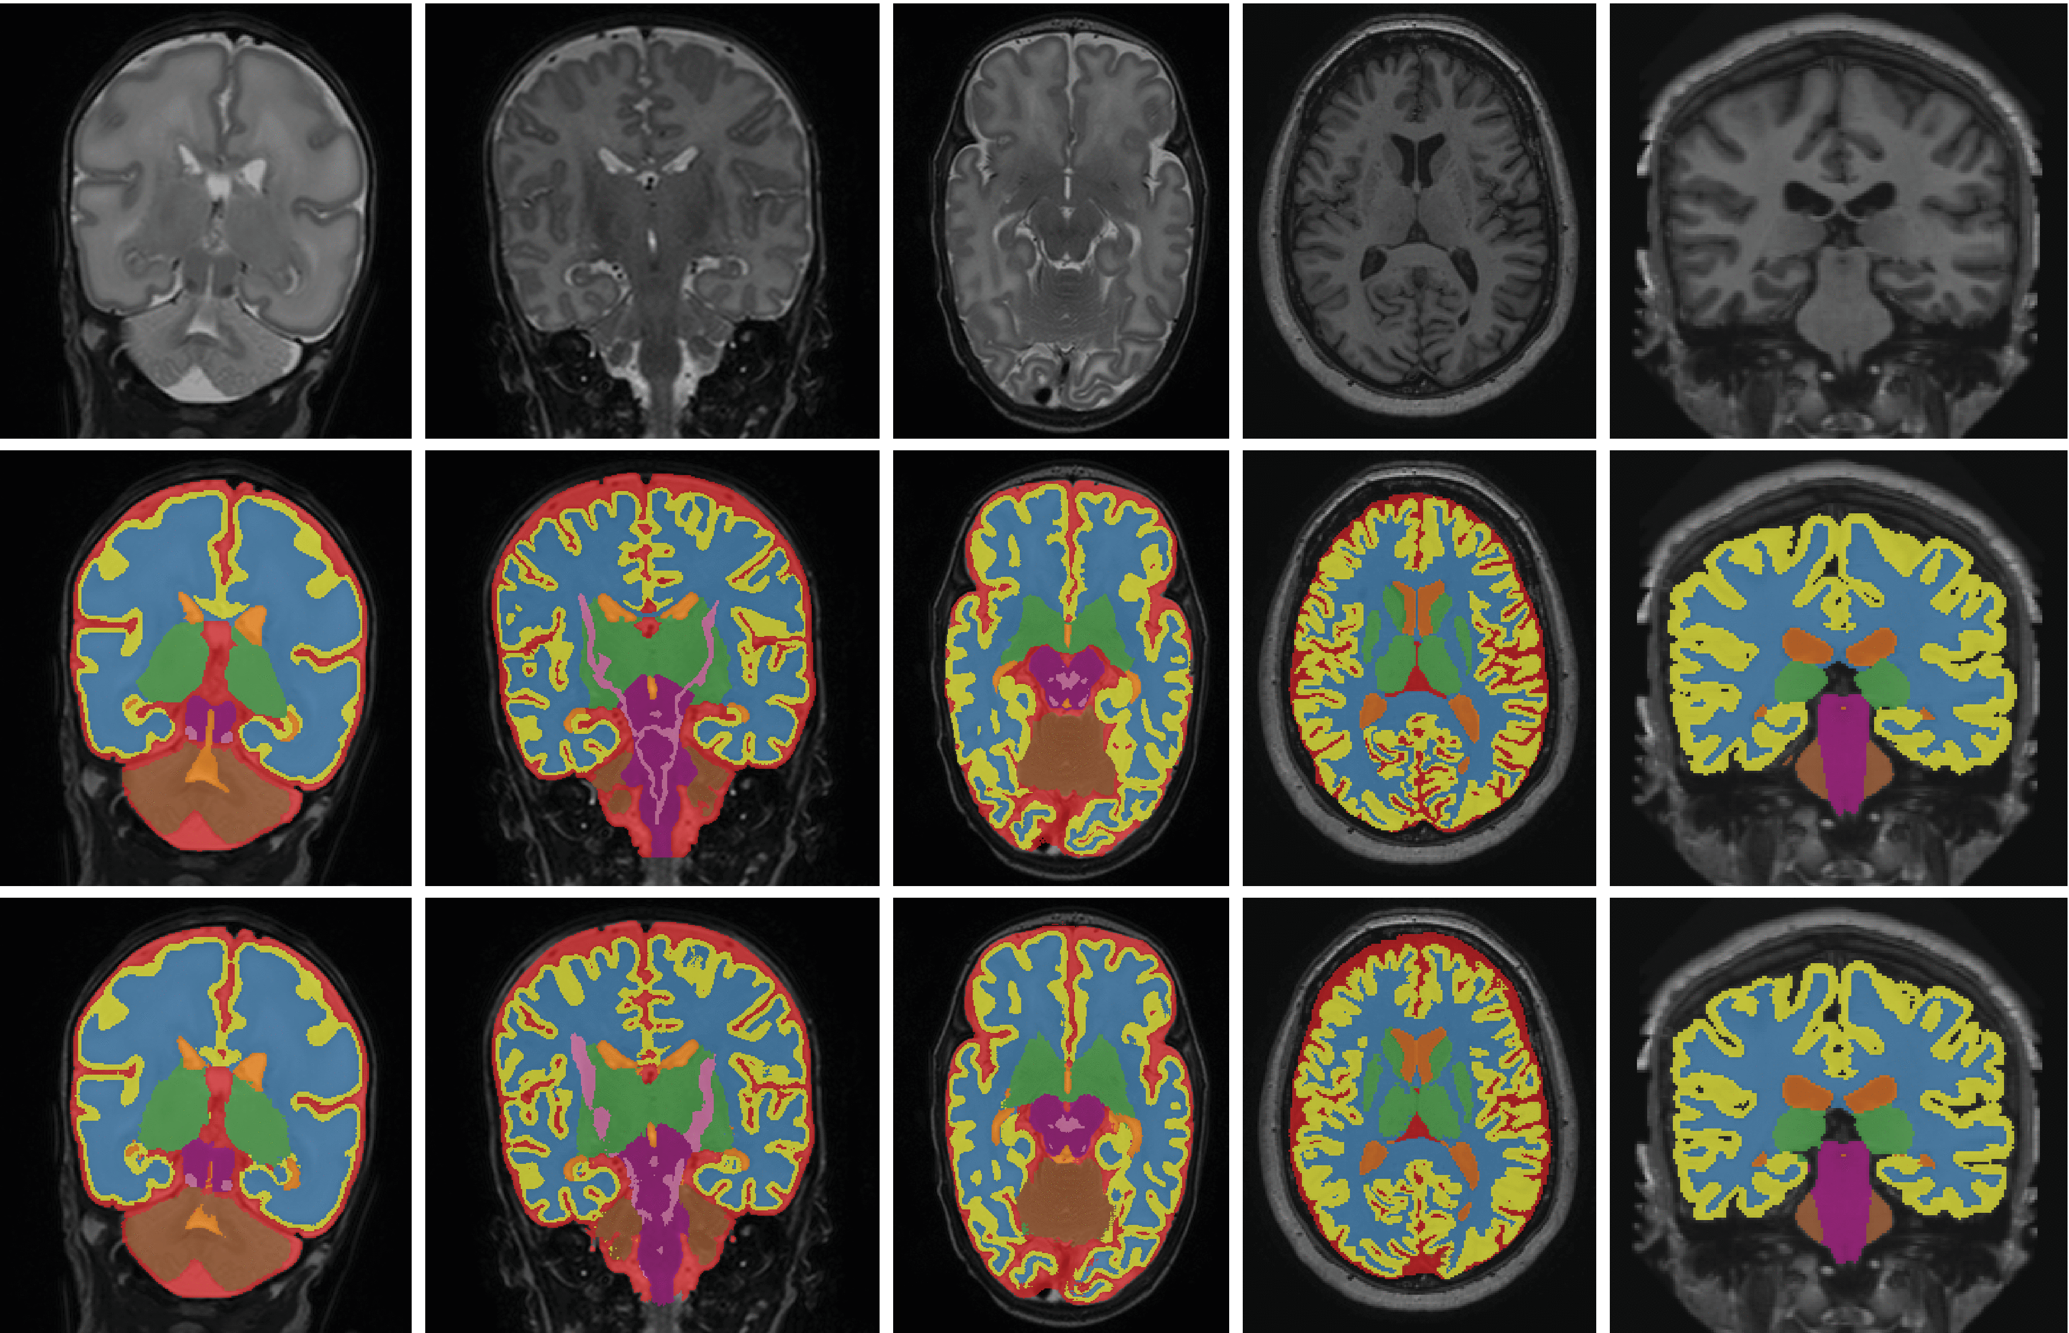
Why Segment? -> Determine Areas or Volumes
Notes:
Discuss lesion burden in MS
Tumor burden
Cardiomyopathy
Grey matter / white matter volume / volume of midbrain structures
Limit measures to specific structures

Slide 17
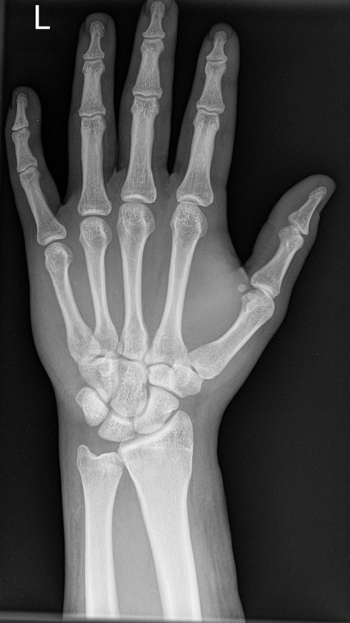
Why Segment? -> Extract features when direct classification is not feasible
Segment
Bones
Calculate lengths and areas
Simple Classifier for Genetic or Growth Disorder

Slide 18
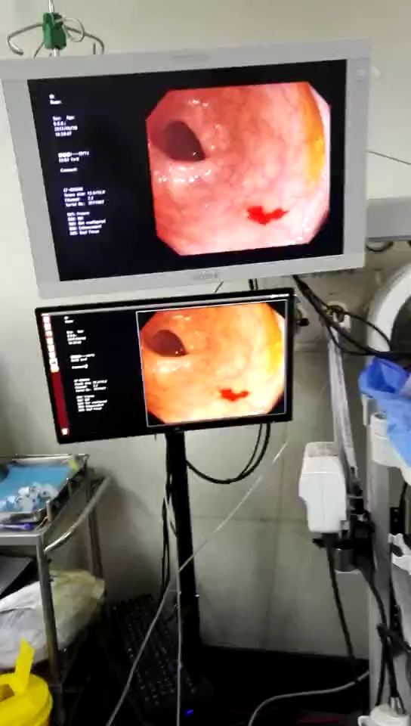
Segmentation of Colon Polyps in Real Time

Slide 19
What do they all have in common?
Predictions are made with a convolutional neural network (CNN), which is a neural network with convolutional (rather than fully-connected) layers.
These models are not trained from scratch. Instead of beginning with random parameters, we begin with parameters learned from a different, usually non-medical task.
Notes:
Note alternatives to CNN

Slide 20
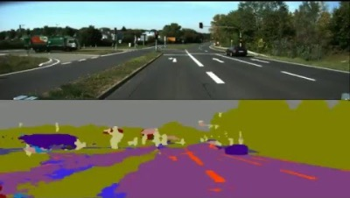
Approach: Start with SegNet, then re-train to identify polyps

Slide 21
What do they all have in common?
Predictions are made with a convolutional neural network (CNN), which is a neural network with convolutional (rather than fully-connected) layers.
These models are not trained from scratch. Instead of beginning with random parameters, we begin with parameters learned from a different, usually non-medical task.
Why is this a good idea?
How can we develop our own CNN model?

Slide 22
How do CNNs work?
Hierarchical feature extraction (like the MLP).
Notes:
Intuitive perspective
Interactive
More details in async

Slide 23
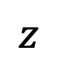
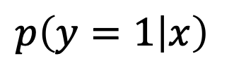
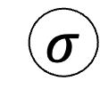
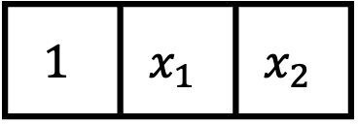

Recall: the MLP
$$p\left(y=1 | x\right)$$
$$σ$$
$$z$$
The MLP allowed us to detect complex, nonlinear features…
older male OR younger female
high OR low blood pressure
specific patient profiles
different handwritten digit styles
…by first identifying simpler features.
The model makes predictions about the complex features based on which simple features are detected.
Hidden Layer
$$h$$
$$1$$ | $$x_{1}$$ | $$x_{2}$$
Intercept
Age >60
Sex
Notes:
We can do this because h and \sigma(h) are always the same size!

Slide 24
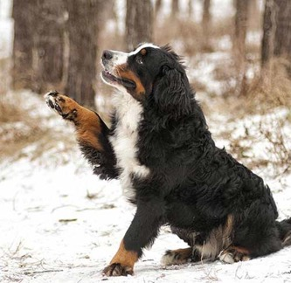
The relationship between individual pixels and the outcome is not linear.
y, associated value or label
x, data/features for a subject or patient
End goal: predict y from x
Notes:
Let’s contrast that with image processing
Want a model that identifies “Bernese Mountain dog”
What are the predictors here?
First: a single pixel has little to do with the outcome
Second: pixels are arranged in a meaningful way – not true of the previous model

Slide 25
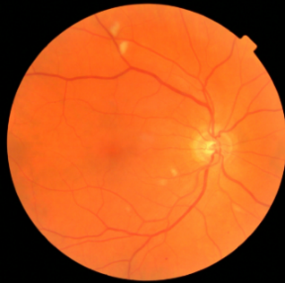
The relationship between individual pixels and the outcome is not linear.
y, associated value or label
x, data/features for a subject or patient
End goal: predict y from x
Notes:
The same is true for medical images
Thinking about this fundoscopic image, does it really matter whether a specific pixel is light versus dark?
What matters are the pixels in relation to one another.
Together they form vessels, suggest exudates, comprise the optic disk – but in isolation, they are near meaningless

Slide 26
We must build a hierarchy of features.
low-level motifs
high-level motifs
dog
label
pixels
End goal: predict dog from pixels
Notes:
In APACHE we can go straight from predictors to label
here we have to build up our understanding of the image bit by bit.
pixels… → lines, arcs, textures
lines and arcs → shapes, contours
Shapes, contours → paw, ear, eye
Paw, ear, eye → dog
All these patterns – we call them motifs
And they are arranged in a hierarchy

Slide 27
We must build a hierarchy of features.
high-level motifs are
specific arrangements
of low-level motifs
low-level motifs
high-level motifs
dog
edges
shapes
textures
eyes
ears
paws
label
pixels
End goal: predict dog from pixels
Notes:
Hinton:
“If there were simple rules”… it wouldn’t have taken us until 2012 to figure this out.
So, is there a simple rule you can use to determine whether a dog is present?
Maybe…. If the rule can be in terms eyes, ears, and paws
Rule for paws is based on shapes
Rule for shapes is based on pixels

Slide 28
We must build a hierarchy of features.
low-level motifs
high-level motifs
retinopathy
edges
shapes
textures
microaneurysm
exudates
hemorrhage
label
pixels
End goal: predict retinopathy from pixels
Notes:
what might features at different levels of THIS hierarchy look like?
top level: retinopathy
high level: microaneurysms, exudates, hemorrhage, etc…
mid level: blood vessels, retinal textures, etc.
Low level: edges, curves, etc. same as before!

Slide 29
We must build a hierarchy of features.
low-level motifs are common to all naturalistic images…
low-level motifs
high-level motifs
retinopathy
edges
shapes
textures
microaneurysm
exudates
hemorrhage
label
pixels
End goal: predict retinopathy from pixels
Notes:
the high level stuff is very different when talking about retina versus talking about dog.
But the low level stuff, that’s common to all images.
And so, when we learn these models, we have to learn the high level stuff anew each time.
But how to detect the low level stuff -- that we can just remember from other models.

Slide 30
Why start with a pre-trained model?
Instead of beginning with random parameters, we begin with parameters learned from a different, usually non-medical task.
This is because these parameters are better than random: many features that are helpful in classifying naturalistic images are also helpful in classifying medical images.
This is particularly true early in the feature hierarchy (i.e. low-level motifs; early layers).

Slide 31
How do we build our CNN?
Copy, modify, fine-tune. We will focus on whole-image classification.

Slide 32
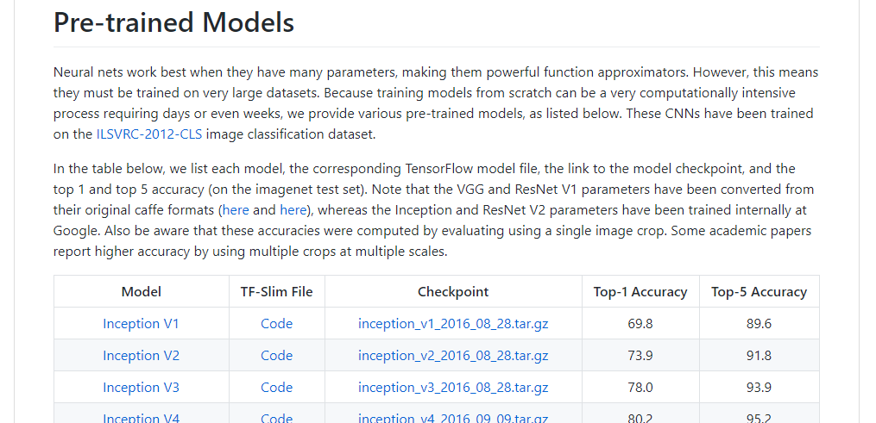
Step 1. Download a trained image classification model.
Python Code:
Defines the model architecture
Checkpoint File:
Contains parameters of the trained model
https://github.com/tensorflow/models/tree/master/research/slim#Pretrained
Notes:
CODE -> architecture
CHECKPOINT -> parameters

Slide 33
We can divide this model into two pieces:
retinopathy
label
A CNN image encoder that converts the raw image to a vector of high-level motifs / features.
A final layer, or prediction head – this is a logistic regression model – that makes predictions about the label from these high-level features.
We will reuse the encoder but replace the prediction head, since it is specific to the previous (non-medical) task.
vector of high-
level features
CNN
Encoder
image

Slide 34
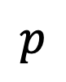
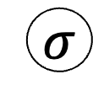
(Enhance!) Inspecting the prediction head:
$$p$$
Predicted probability of retinopathy
In this example, our prediction head is simple logistic regression on the features extracted by the CNN encoder.
$$σ$$
z
Predicted log-odds
of retinopathy
vector of high-
level features
CNN
Encoder

Slide 35
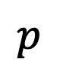
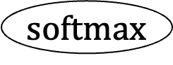
(Enhance!) Inspecting the prediction head:
$$p$$
Predicted probability of dog, cat, fish
In this example, our prediction head is simple logistic regression on the features extracted by the CNN encoder.
Typically, we start with a multi-class (rather than binary) prediction head.
$$softmax$$
Softmax function
(i.e. multi-class sigmoid)
z
Predicted log-odds
of dog, cat, fish
vector of high-
level features
CNN
Encoder

Slide 36
Step 2: Replace the prediction head.
$$p$$
Predicted probability of dog, cat, fish
In this example, our prediction head is simple logistic regression on the features extracted by the CNN encoder.
Typically, we start with a multi-class (rather than binary) prediction head.
We want to make predictions about a new set of labels, so we cut off the prediction head…
$$softmax$$
Softmax function
(i.e. multi-class sigmoid)
z
Predicted log-odds
of dog, cat, fish
vector of high-
level features
CNN
Encoder

Slide 37
Step 2: Replace the prediction head.
In this example, our prediction head is simple logistic regression on the features extracted by the CNN encoder.
Typically, we start with a multi-class (rather than binary) prediction head.
We want to make predictions about a new set of labels, so we cut off the prediction head…
vector of high-
level features
CNN
Encoder

Slide 38
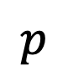
Step 2: Replace the prediction head.
Predicted probability of melanoma, carcinoma, keratosis, nevus
$$p$$
In this example, our prediction head is simple logistic regression on the features extracted by the CNN encoder.
Typically, we start with a multi-class (rather than binary) prediction head.
We want to make predictions about a new set of labels, so we cut off the prediction head…
…and replace it with a new one appropriate for our new prediction task.
$$softmax$$
z
Predicted log-odds of melanoma, carcinoma, keratosis, nevus
vector of high-
level features
CNN
Encoder

Slide 39
Step 3: Train it on your data.
Finally, you train the model with your dataset of medical images.
You train the same way you’d train any other model.*
The prediction head is new, so parameters in this layer are learned entirely from your data.
The CNN encoder is not new, so we say parameters in the encoder are fine-tuned to your data.
You’ll need a big dataset (e.g. 1k), but since you started with a pre-trained model, not as big as if you trained from scratch (e.g. 1M).
This process (steps 1-3) is called transfer learning.
*with a few caveats

Slide 40
Some notes on fine-tuning:
fine-tuning a pre-trained model tends to be at least as good as learning from scratch
(empirical result)
2) freeze early layers and fine-tune later layers
more data → fine-tune more layers
3) best tuning depth depends on the application, and should be explored as a hyperparameter
Notes:
~130k images -> they fine-tune all layers

Slide 41
Image Data Preprocessing
…also called data augmentation

Slide 42
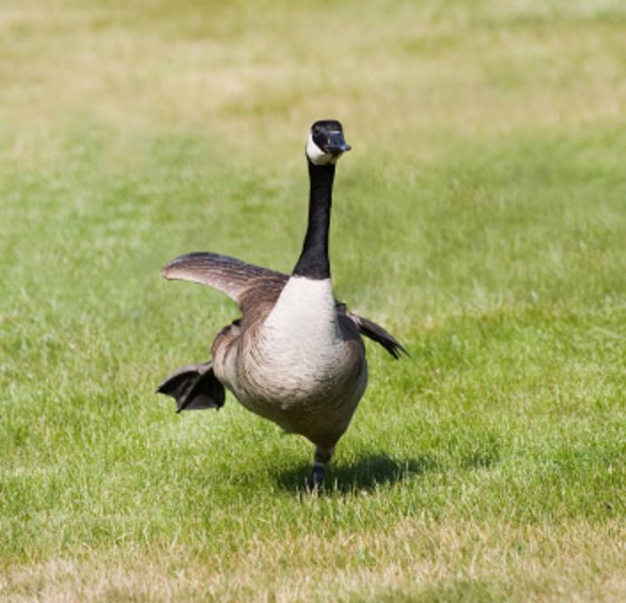
CNN: I know this one, it’s a goose!

Slide 43
CNN: I have no idea what this is.

Slide 44
CNN: I’ve never seen anything like this in my life.

Slide 45
CNN: I don’t see anything.

Slide 46
CNN: I think this is a space shuttle.

Slide 47
Solution: Augment your dataset
Apply random rotations, crops, brightness adjustments, stretching, etc
The details depend on the application.

Slide 48
Summary
CNNs can classify images or detect objects within images, including medically relevant findings.
CNNs work through hierarchical extraction of increasingly complex features.
We can re-purpose a trained CNN to classify medical images by:
Finding and downloading code and parameters defining the existing model
Replacing the final layer (i.e., prediction head) with a new one suitable for our task
Training the model with our dataset to learn parameters in the prediction head and fine-tune parameters in the CNN encoder
Applying random rotations, crops, brightness adjustments, etc during training makes the model robust to these variations if/when they are encountered

